Slide 1

Capstone Project 3
Credit Card Default Prediction Team Details Kundan Lal(Coh Hardeol) , Abhijeet Kulkarni Pankaj Ganjare , Akshay Auti

Slide 2

Problem Statement: This project is aimed at predicting the case of customers default payments in Taiwan. From the perspective of risk management, the result of predictive accuracy of the estimated probability of default will be more valuable than the binary result of classification - credible or not credible clients

Slide 3

Content
Data Description
Attribute Information
Summary of Data
Data Pre-processing
Data Visualization
Heat Map
Standard Normalization
Data Training & Testing
Algorithms For Machine Learning
Hyper Parameter Tuning
Conclusion

Slide 4
Data Description: This research employed a binary variable, default payment (Yes = 1, No = 0), as the response variable. This study reviewed the literature and used the following 23 variables as explanatory variables: X1: Amount of the given credit (NT dollar): it includes both the individual consumer credit and his/her family (supplementary) credit. X2: Gender (1 = male; 2 = female). X3: Education (1 = graduate school; 2 = university; 3 = high school; 4 = others). X4: Marital status (1 = married; 2 = single; 3 = others). X5: Age (year). X6 - X11: History of past payment X7 = the repayment status in August, 2005 X11 = the repayment status in April, 2005. The measurement scale for the repayment status is: -1 = pay duly(properly paid); 0 = not delayed ;, 1 = payment delay for one month; 2 = payment delay for two months; . . .; 8 = payment delay for eight months; 9 = payment delay for nine months and above. X12-X17: Amount of bill statement (NT dollar) X18-X23: Amount of previous payment (NT dollar)

Slide 5
Attribute Information : Null Values and Dtypes: <class 'pandas.core.frame.DataFrame’> RangeIndex: 30000 entries, 0 to 29999 Data columns (total 25 columns): # Column Non-Null Count Dtype --- ------ -------------- ----- 0 ID 30000 non-null int64 1 LIMIT_BAL 30000 non-null int64 2 SEX 30000 non-null int64 3 EDUCATION 30000 non-null int64 4 MARRIAGE 30000 non-null int64 5 AGE 30000 non-null int64 6 PAY_0 30000 non-null int64 7 PAY_2 30000 non-null int64 8 PAY_3 30000 non-null int64 9 PAY_4 30000 non-null int64 10 PAY_5 30000 non-null int64 11 PAY_6 30000 non-null int64 12 BILL_AMT1 30000 non-null int64 13 BILL_AMT2 30000 non-null int64 14 BILL_AMT3 30000 non-null int64 15 BILL_AMT4 30000 non-null int64 16 BILL_AMT5 30000 non-null int64 17 BILL_AMT6 30000 non-null int64 18 PAY_AMT1 30000 non-null int64 19 PAY_AMT2 30000 non-null int64 20 PAY_AMT3 30000 non-null int64 21 PAY_AMT4 30000 non-null int64 22 PAY_AMT5 30000 non-null int64 23 PAY_AMT6 30000 non-null int64 24 default payment next month 30000 non-null int64 dtypes: int64(25) memory usage: 5.7 MB

Slide 6
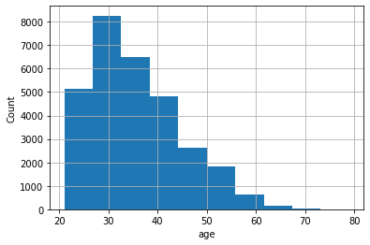
Data Visualization
From graph we know that
Credit Card holders whose ages are between 28 to 37 Yrs are highest in numbers

Slide 7
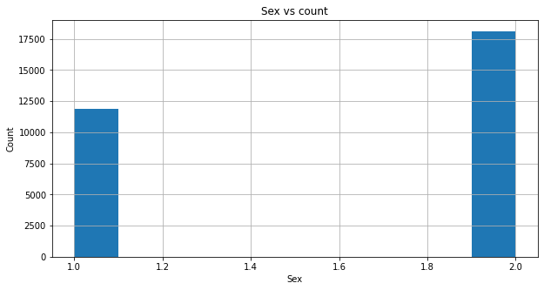
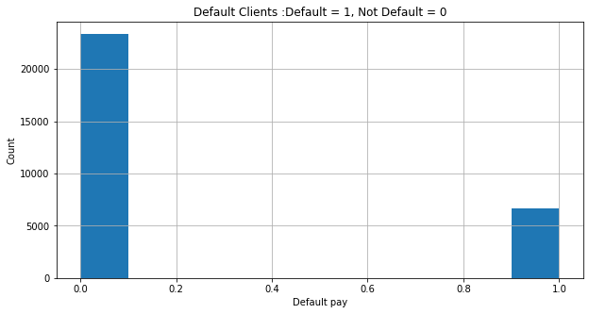
Analysis based on Gender (1 = Male; 2 = Female)
Females contains more numbers of credit cards as compare to males
Numbers of Default and Non Default credit card holders
Percentage of Defaulters are much lesser than the Non Defaulters in the given dataset

Slide 8
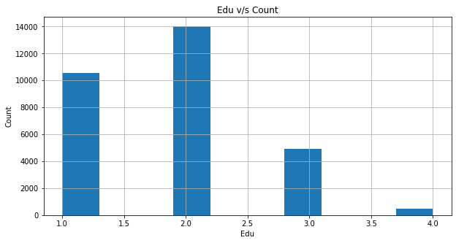
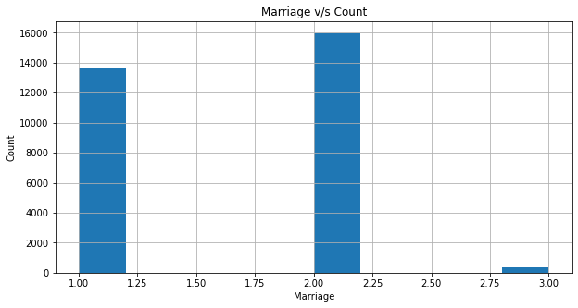
University passed outs has highest numbers of credit card holders followed by Graduate School.
Analysing on Marriage Basis (1 = married; 2 = single; 3 = others)
More number of credit cards holder are Singles followed by Married ones.
Analysing on Education Basis (1 = graduate school; 2 = university; 3 = high school; 4 = others)

Slide 9
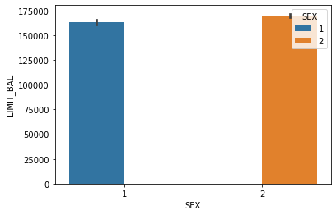
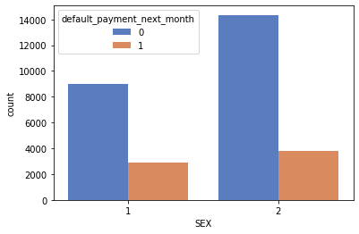
sns.barplot sex vs limit_bal Credit Limit of Male members are marginally less as compare to females.
sns.countplot vs default payment next month
Males Default on payment next Month 60%- 70% more than Females .

Slide 10
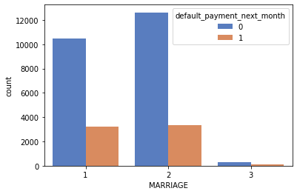
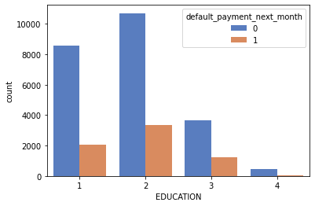
sns.countplot marriagre vs default_payment_next_month From plot it is clear that Unmarried people have more defaulted on payment as compared to Married People.
countplot education vs default_payment_next_month
From plot it is clear that people Graduates Default Much more as compared to University and High Schools.

Slide 11
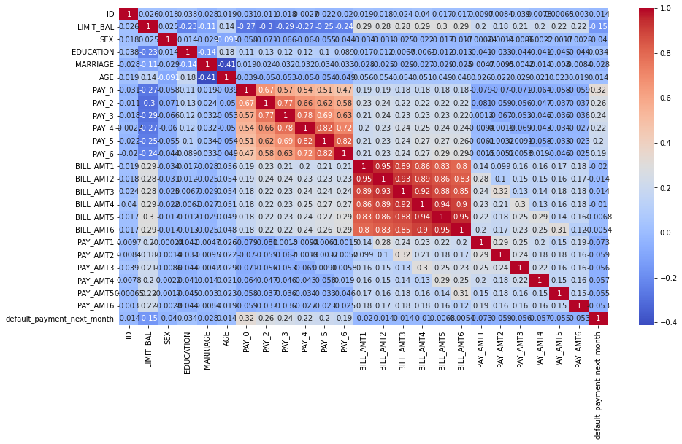
Analyzing Multi Collinearity via Heat Map

Slide 12
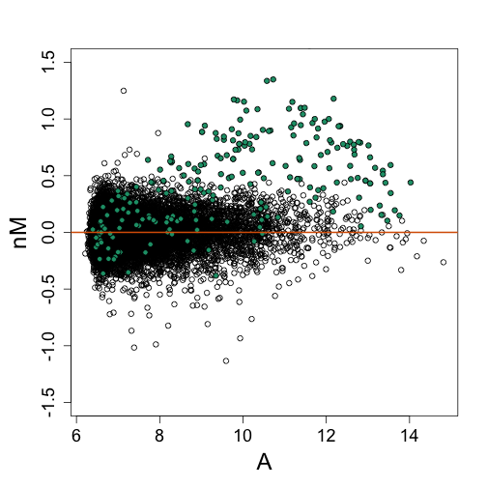
Process of Normalization
Normalization is a scaling technique in Machine Learning applied during data preparation to change the values of numeric columns in the dataset to use a common scale. It is not necessary for all datasets in any model. It is required only when features of machine learning models have different ranges (Scales).

Slide 13
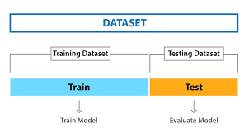
Train / Test Splitting of Data

Slide 14
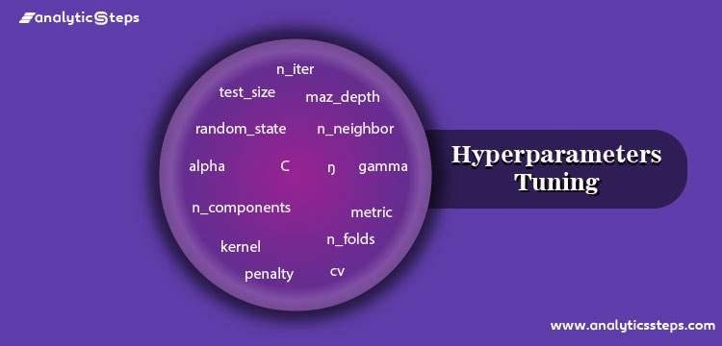
Hyper Parameter Tuning & its Importance (Manual Tuning)
Hyper parameter tuning is an essential part of controlling the behavior of a machine learning model. If we don't correctly tune our hyper parameters, our estimated model parameters produce suboptimal results, as they don't minimize the loss function. This means our model will makes more errors if not tuned properly.
Alfa , Gamma, Max Depth , Kernel , K- values etc.)

Slide 15
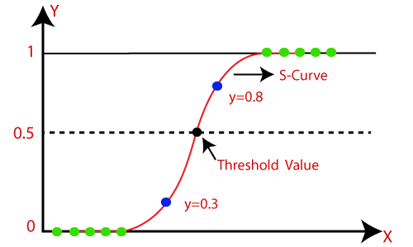
Introduction to Logistics Regression
Logistic regression is an example of supervised learning. It is used to calculate or predict the probability of a binary (yes/no) event occurring.

Slide 16
Logistic Regression Metric Values
Y Train Values
Y Test Values
Model | Accuracy | Precision | Recall | F1 Score | ROC
Logistic Regression | 0.807429 | 0.70529 | 0.238501 | 0.356461 | 0.604898
Model | Accuracy | Precision | Recall | F1 Score | ROC
Logistic Regression | 0.816556 | 0.738056 | 0.230928 | 0.351786 | 0.604203

Slide 17
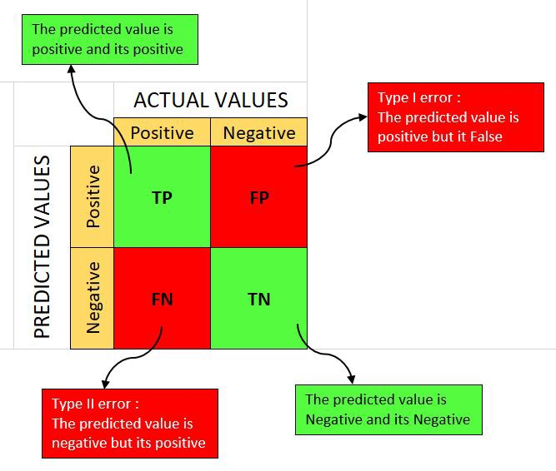


Confusion Matrix
F1-score is the harmonic mean of precision and recall. It combines precision and recall into a single number using the following formula: This formula can also be equivalently written as, Notice that F1-score takes both precision and recall into account, which also means it accounts for both FPs and FNs
Accuracy is a metric for classification models that measures the number of predictions that are correct as a percentage of the total number of predictions that are made. As an example, if 90% of your predictions are correct, your accuracy is simply 90%.

Slide 18
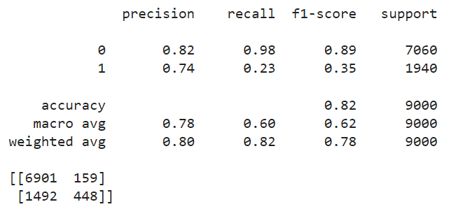
Classification Report & Confusion matrix of Logistics Regression

Slide 19
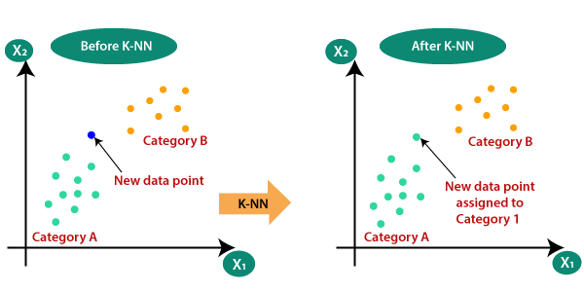
Introduction to KNN
The abbreviation KNN stands for “K-Nearest Neighbour ”. It is a supervised machine learning algorithm. The algorithm can be used to solve both classification and regression problem statements. The number of nearest neighbors to a new unknown variable that has to be predicted or classified is denoted by the symbol 'K'

Slide 20
KNN Metric Values
Y Train Values
Y Test Values
Model | Accuracy | Precision | Recall | F1 Score | ROC
KNN Classifier | 0.843238 | 0.727184 | 0.478492 | 0.57719 | 0.713394
Model | Accuracy | Precision | Recall | F1 Score | ROC
KNN Classifier | 0.789444 | 0.5179 | 0.335567 | 0.407257 | 0.624866

Slide 21
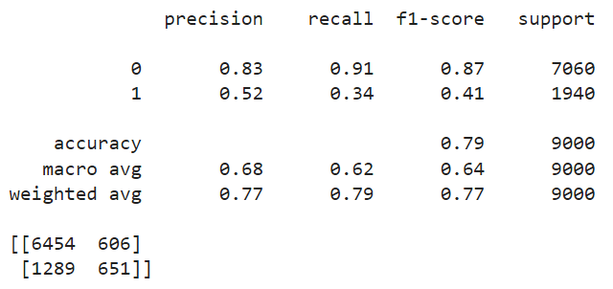
Classification Report & Confusion matrix of KNN

Slide 22
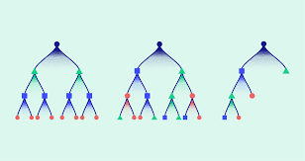
XGBoost Classifier(uses GPU thus Faster)
XGBoost is an algorithm that has recently been dominating applied machine learning and ML competitions for structured or tabular data.
XGBoost is an implementation of gradient boosted decision trees designed for speed and performance.

Slide 23
XGBoost Metric Values
Y Train Values
Y Test Values
Model | Accuracy | Precision | Recall | F1 Score | ROC
XGBOOST Classifier | 0.823714 | 0.696443 | 0.375213 | 0.487683 | 0.664054
Model | Accuracy | Precision | Recall | F1 Score | ROC
XGBOOST Classifier | 0.824778 | 0.676043 | 0.359278 | 0.469202 | 0.655985

Slide 24
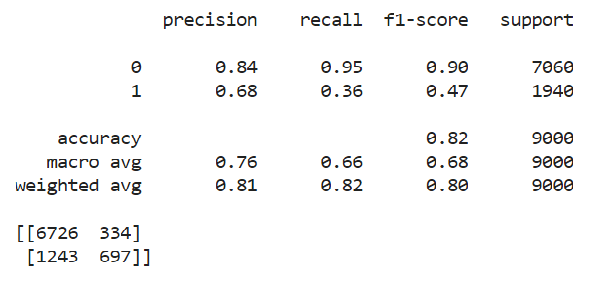
Classification Report & Confusion matrix XG Boost

Slide 25
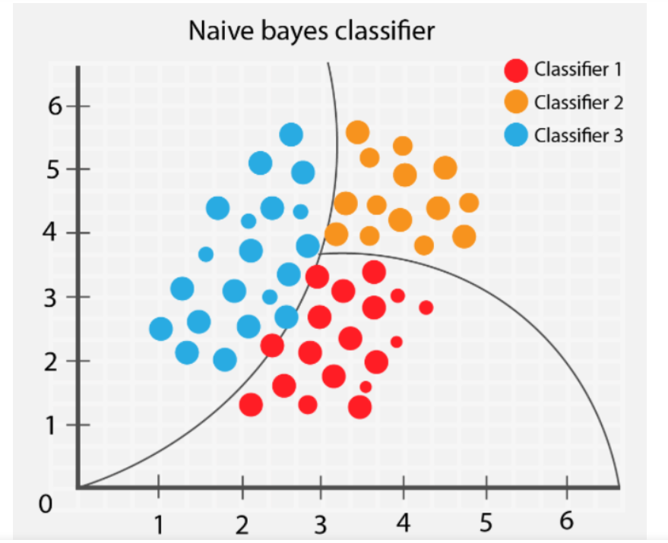
Naive Bayes
Naive Bayes Classifiers are a family of simple "probabilistic classifiers" based on applying Bayes' theorem with strong independence assumptions between the features. They are among the simplest Bayesian network models, but coupled with kernel density estimation, they can achieve high accuracy levels.
P(A|B) = P(B|A). P(A) / P(B)

Slide 26
Naive Bayes Metric Values
Y Train Values
Y Test Values
Model | Accuracy | Precision | Recall | F1 Score | ROC
Gaussian Naive Bayes | 0.588571 | 0.321506 | 0.756388 | 0.45122 | 0.648312
Model | Accuracy | Precision | Recall | F1 Score | ROC
Gaussian Naive Bayes | 0.584778 | 0.309276 | 0.751031 | 0.43813 | 0.645062

Slide 27
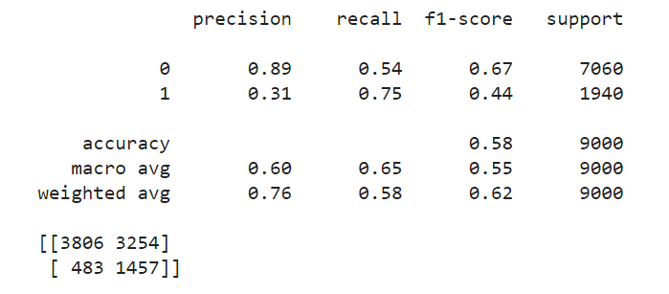
Classification Report & Confusion matrix Naive Bayes

Slide 28
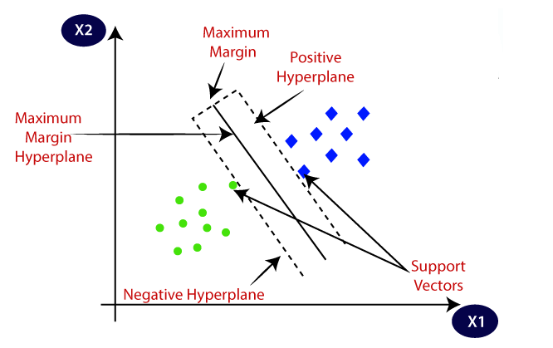
SVM
The goal of the SVM algorithm is to create the best line or decision boundary that can segregate n-dimensional space into classes so that we can easily put the new data point in the correct category in the future. This best decision boundary is called a hyperplane.

Slide 29
SVM Metric Values
Y Train metric Values
Y Test metric Values
Model | Accuracy | Precision | Recall | F1 Score | ROC
SVM | 0.806524 | 0.703799 | 0.232751 | 0.349816 | 0.602269
Model | Accuracy | Precision | Recall | F1 Score | ROC
SVM | 0.815 | 0.718601 | 0.23299 | 0.351888 | 0.603959

Slide 30
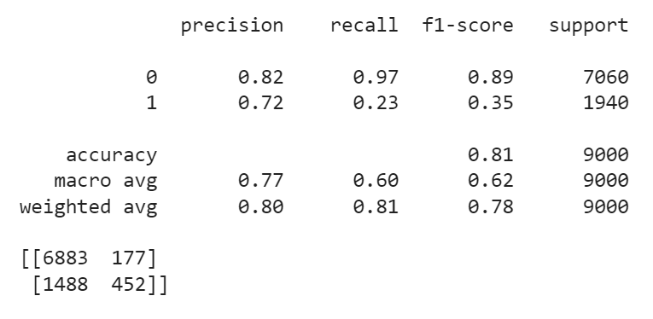
Classification Report & Confusion matrix of SVM

Slide 31
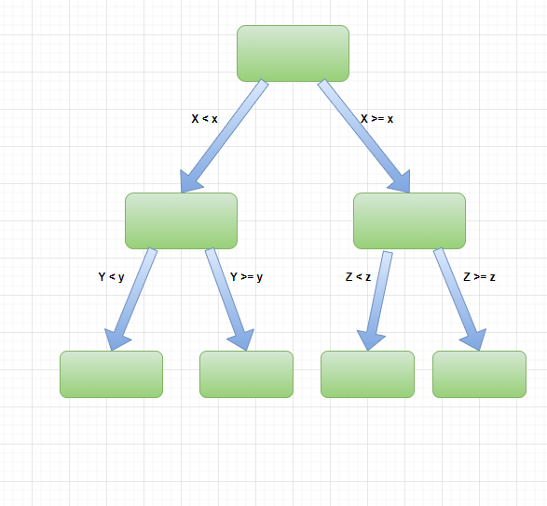
Decision Tree
A Decision Tree is a graphical representation of possible solutions to a decision based on certain conditions. It’s called a decision tree because it starts with a single box (or root), which then branches off into a number of solutions, just like a tree.

Slide 32
Decision Tree Metric Values
Y Train metric values
Y Test metric Values
Model | Accuracy | Precision | Recall | F1 Score | ROC
Decision Tree | 0.999714 | 0.999787 | 0.998935 | 0.999361 | 0.999437
Model | Accuracy | Precision | Recall | F1 Score | ROC
Decision Tree | 0.731111 | 0.385932 | 0.418557 | 0.401583 | 0.617777

Slide 33
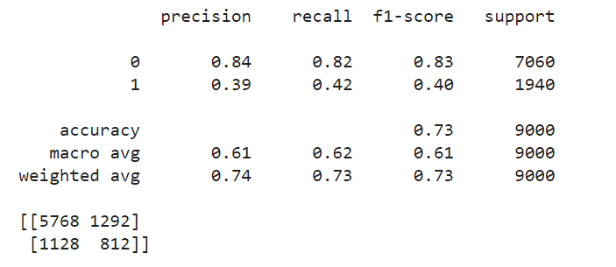
Classification Report & Confusion matrix of Decision Tree

Slide 34
Conclusion:
Technical Conclusion
XGBoost was able to Predict best with 82% accuracy score , Followed by Logistics Regression & SVM at 81% , But Confusion Matrix of Logistics Regression shown better values ,so overall Logistics Regression Worked Best .
General Conclusion
Married ,more Educated Female Credit Card Users , whose ages are between 28-37 and are least likely to default on their payments ,
Single Men , less educated whose ages are lesser than 28 or more than 37 are most likely to default on payments ,
Accordingly the company can device strategy for their target customers (for better Profitability) .

